Slide 1
Liquid Nitrogen and Cryogenics Training

Slide 2
Potential Hazards
Health
Vapors may cause dizziness or asphyxiation without warning.
Vapors from liquefied gas are initially heavier than air and spread along ground.
Contact with gas or liquefied gas may cause burns, severe injury, and/or frostbite.

Slide 3
Personal Protective Equipment
Always wear thermal protective clothing when handling refrigerated/cryogenic liquids or solids.
It is required you wear a full face shield over safety glasses, loose fitting gauntlet gloves, full-length trousers without cuffs, and fully enclosed shoes.

Slide 4
Public Safety
Immediately call emergency personnel in the event of a large spill or leak.
9-1-1 from any phone or (309)438-8631 for ISUPD dispatcher
Isolate large spills or leaks for at least 100 meters in all directions.
Keep unauthorized personnel away.
Stay upwind.
Keep out of low areas.
Ventilate closed spaces before entering.

Slide 5
Potential Hazards
Explosion
Liquid Nitrogen must be transported and stored in an appropriate container containing pressure relief devices.
If pressure builds up, the stopper could be "rocketed out" or the container could explode

Slide 6
Container Requirements
Closed container with a loose fitting top that allows venting.
Use only vessels designed for extreme cold (i.e. insulated).
Vessel must have carrying handles or be on wheels or a cart.

Slide 7
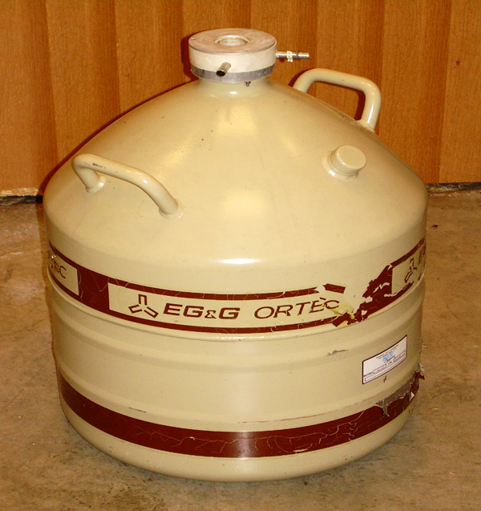
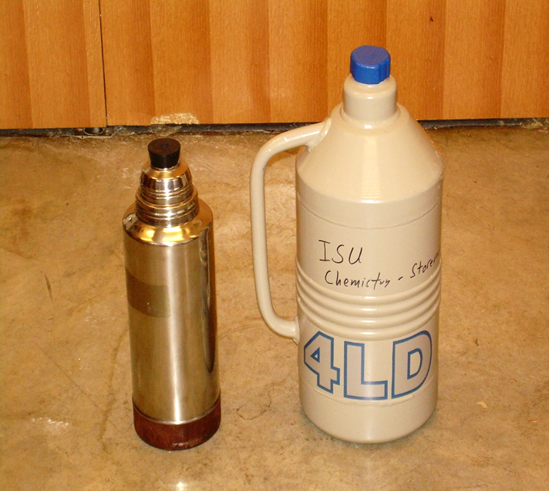
Appropriate Containers
Examples of acceptable cryogenic Dewar's:

Slide 8
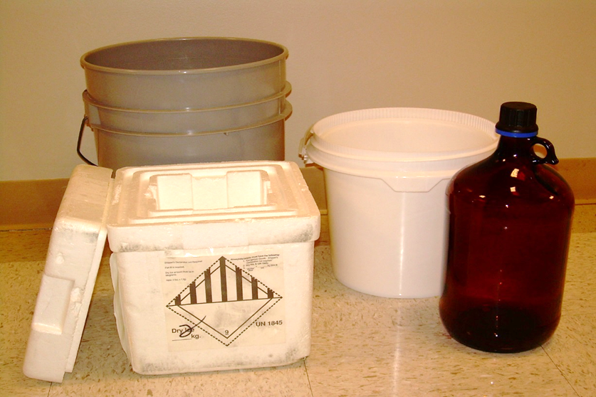
Inappropriate Containers
DO NOT use open, un-insulated or glass containers!

Slide 9
Liquid Nitrogen Dewar
Located in the loading dock in Science Lab Building.
Obtain the dewar key from the Chemistry Stockroom, SLB 110.

Slide 10
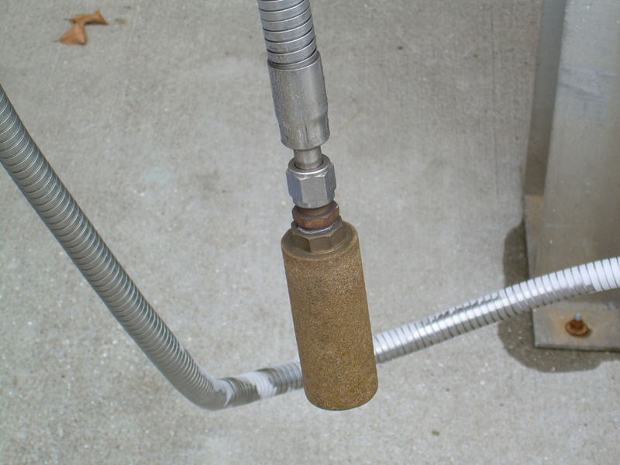
Fill Hose
The liquid Nitrogen is released through the fill hose.

Slide 11
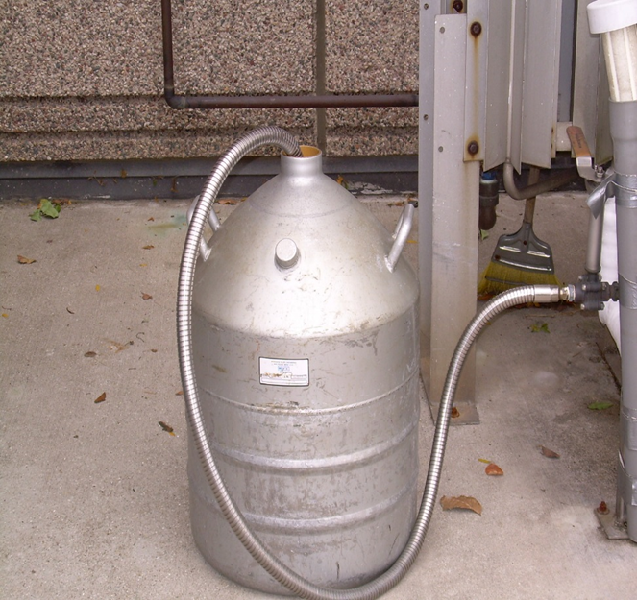
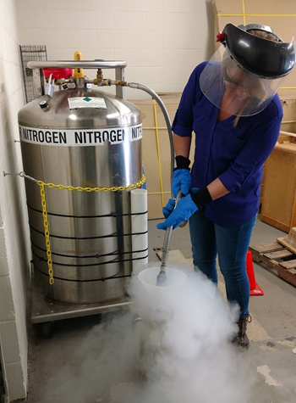
Procedures: Step 1: Fill Hose
Insert and hold the fill hose into the appropriate container or into the funnel.

Slide 12
Procedures: Step 2: Open/Close Valve
Open valve slowly to begin filling.
Close valve tightly after filling.

Slide 13
Procedures: Step 3: Record Use
Sheet is located on the wall next to the dewar.
Record the date, PI name, and amount used.
If you are with the chemistry department, you do not need to record usage.

Slide 14
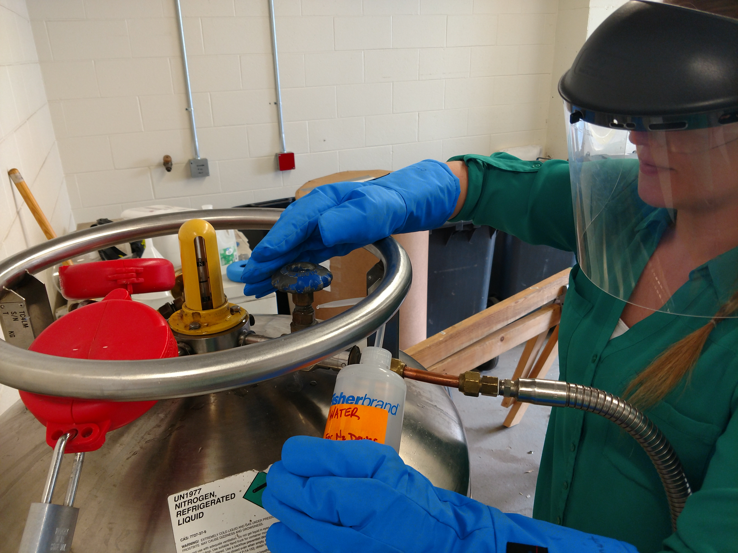
What To Do if the Valve Freezes
Sometimes condensation freezes on the valve and it will not shut all the way.
Use the plastic container to obtain hot water. Pour hot water over the valve until you can twist and close the valve.
If you have problems please seek help from the Chemistry Stockroom SLB 110.

Slide 15
Safe Handling
Only transport liquid nitrogen in the freight elevator with no other occupants present.
Wear Personal Protective Equipment in a well ventilated area when using liquid nitrogen.
Do not store in a confined space.
Do not store at temperatures above 125°F.

Slide 16
Contact
Chemistry Stockroom:
309-438-3766
Environmental Health & Safety:
309-438-8325

