Slide 1


Hazard Communication Training
3D Printer Use
715 W. Raab Rd, Administration Building 1, Normal
Phone: (309)438-8326
Website: https://ehs.illinoisstate.edu/
Email: sysenvironmental@ilstu.edu

Slide 2
Introduction to Hazard Communication
(HazCom)
Purpose: Ensure employees understand chemical and physical hazards of 3D printer use.
Covers labeling, Safety Data Sheets (SDS), and protective measures.
OSHA 'Right to Know' and 'Right to Understand' principles.

Slide 3

Hazards Associated with 3D Printing Chemical Hazards
Thermoplastics (ABS, PLA, PETG, Nylon): Fume and ultrafine particle exposure.
Resins (Acrylate, Methacrylate): Skin/eye irritation, allergic reaction.
Solvents (Isopropyl Alcohol, Acetone): Flammable, inhalation hazard.
Adhesives (Epoxy, Super Glue): Respiratory sensitizer, flammable vapors.

Slide 4
Globally Harmonize System(GHS)
Adopted by OSHA in 2012 as a part of the Hazard Communication Standard.
Worldwide system for standardizing how chemicals are classified and labeled based on their health, physical, and environmental hazards.
Utilizes standard pictograms, signal words and hazard statements

Slide 5
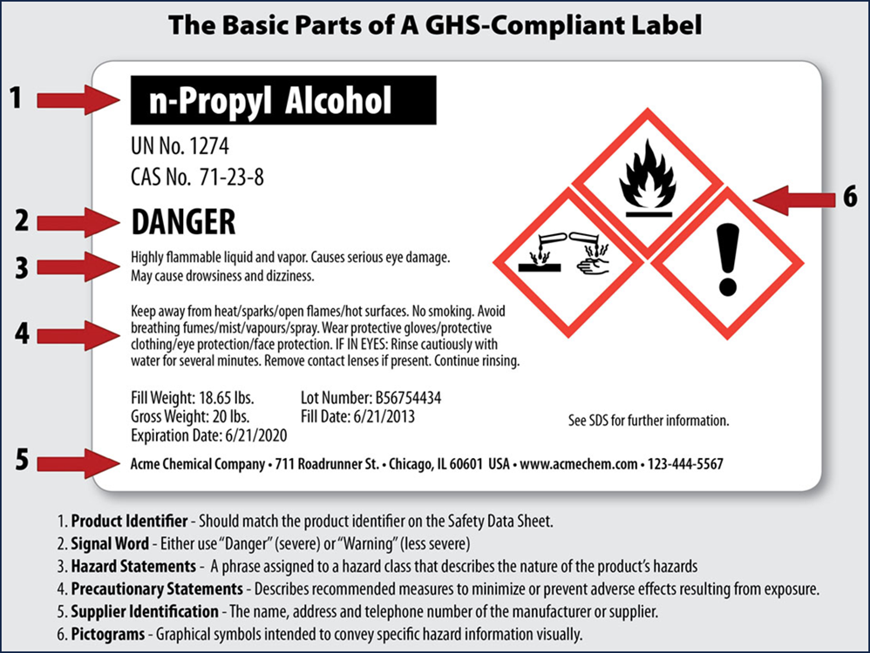
Globally Harmonize System(GHS)

Slide 6
Safety Data Sheets (SDSs)
SDS are multi-page documents that contain more detailed information about a chemical than the container label.
Departmental leads/supervisors shall maintain copies of required SDSs for each hazardous chemical and shall ensure that they are readily accessible during each work shift.
Illinois State University employees have 24/7 access to KHA SDS Online, the University’s online SDS management system. Each department should have a designated administrator of the KHA Online database for their specific area(s).

Slide 7
16-Section SDS Format
Identification
Hazard(s) Identification
Composition/Information on Ingredients
First-Aid Measures
Fire-Fighting Measures
Accidental Release Measures
Handling and Storage
Exposure Controls/Personal Protection
Physical and Chemical Properties
Stability and Reactivity
Toxicological Information
Ecological Information
Disposal Considerations
Transport Information
Regulatory Information
Other Information

Slide 8

Pictograms
A symbol plus a red diamond border intended to convey specific information about the hazards of a chemical.

Slide 9




GHS Hazard Pictogram
Corrosion:
Skin & Metal Corrosion/Burns
Eye Damage
Skull & Crossbones:
Acute Toxicity (fatal or toxic)

Slide 10


GHS Hazard Pictogram
Exclamation Mark:
Irritant (skin and eye)
Skin Sensitizer
Acute Toxicity
Narcotic Effects
Respiratory Tract Irritant
Hazardous to Ozone Layer (non-mandatory)

Slide 11
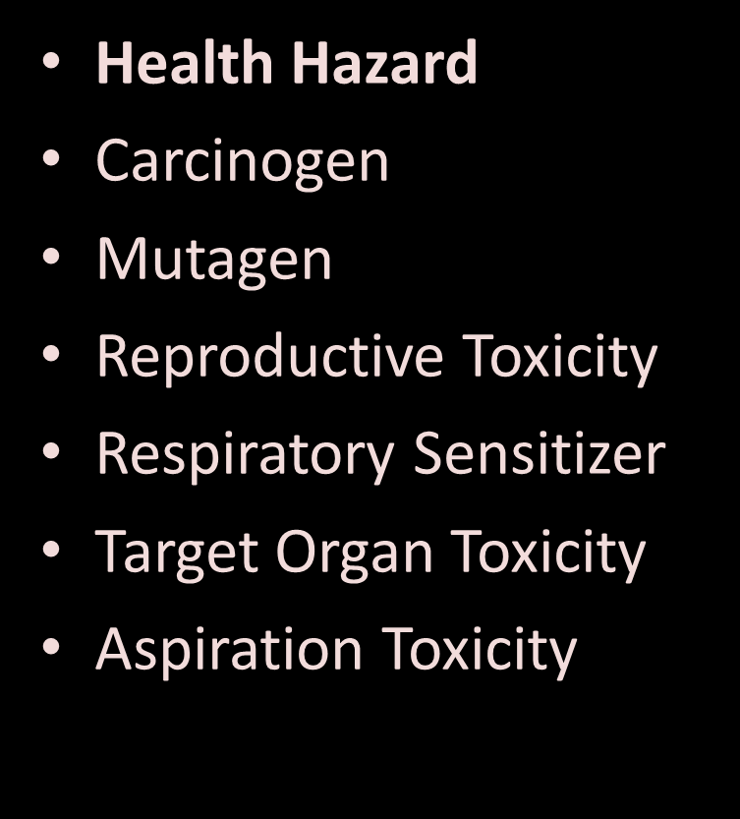

GHS Hazard Pictogram

Slide 12
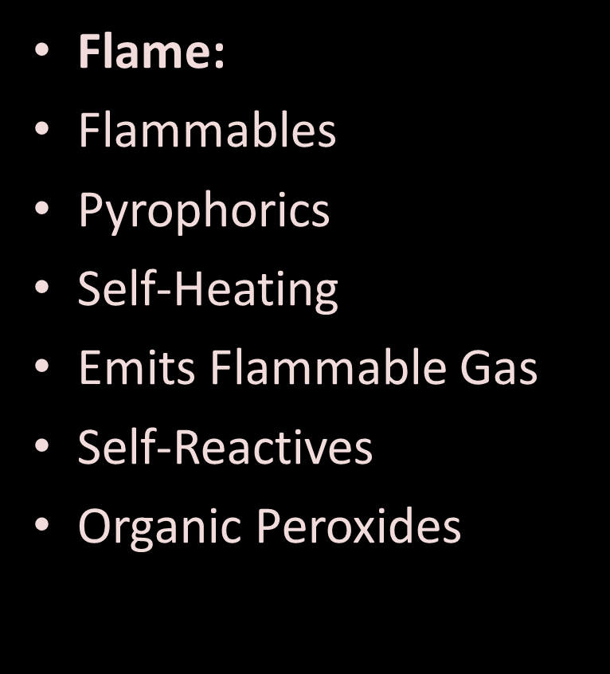


GHS Hazard Pictogram

Slide 13
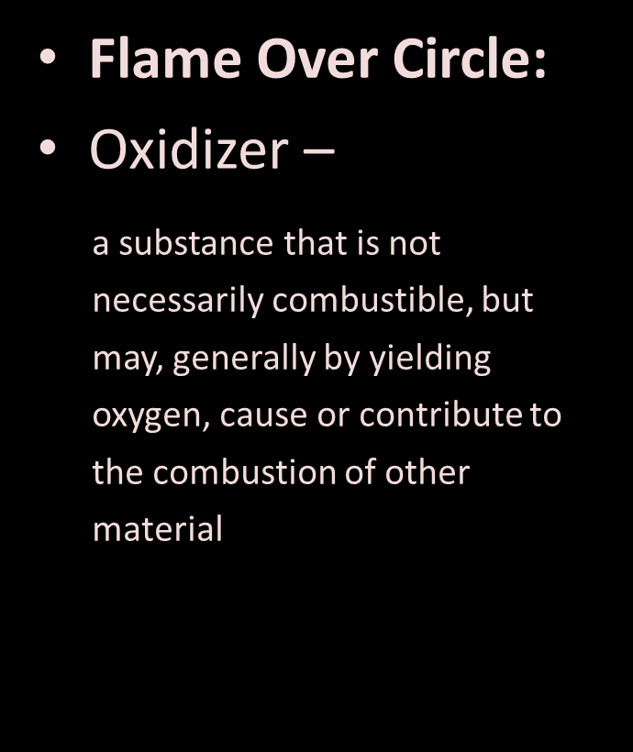

GHS Hazard Pictogram

Slide 14
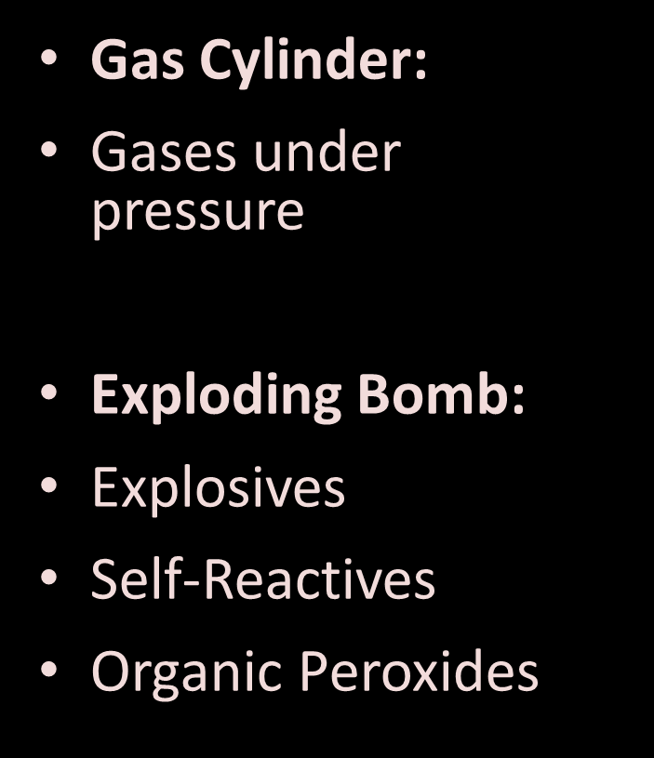



GHS Hazard Pictogram

Slide 15






Slide 16

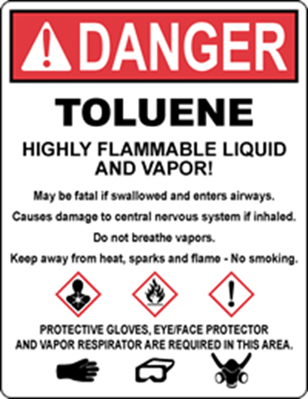

“Danger” – more severe hazards
“Warning” – less severe hazards

Slide 17
Hazards Associated with 3D Printing Physical Hazards
Hot surfaces: Nozzle/bed temperatures >200°C.
Moving parts: Entanglement and pinch hazards.
Electrical and fire hazards from wiring and power supplies.
UV exposure from resin curing lamps.

Slide 18
Container Labeling Requirements
Product identifier, signal word, hazard and precautionary statements.
Pictograms per GHS system.
Manufacturer contact information.
Common pictograms: Flame, Exclamation, Health hazard, Skull & Crossbones.

Slide 19
Safety Data Sheets (SDS)
Know where SDSs are located and how to read them.
Key sections: Identification, Hazards, First Aid, PPE, Handling & Storage.
Example: Isopropyl Alcohol – Flammable, 400 ppm OSHA PEL, use gloves/goggles.

Slide 20
Safe Work Practices - Before Printing
Review SDSs for all materials.
Ensure ventilation or fume extraction.
Inspect printers for damage or frayed cords.

Slide 21
Safe Work Practices - During Printing
Avoid skin contact with resin or melted plastic.
Wear nitrile gloves, safety glasses, lab coat, respirator if needed.
Keep printer enclosures closed.

Slide 22
Safe Work Practices - After Printing
Allow parts to cool before handling.
Clean with approved solvents in ventilated areas.
Dispose of waste properly and wash hands.

Slide 23
Emergency Procedures
Spills: Absorb, ventilate, dispose per SDS.
Fire: Use CO₂ or dry chemical extinguisher.
Skin/Eye Contact: Rinse 15 minutes, seek medical attention.
Inhalation: Move to fresh air, get help if symptoms persist.

Slide 24
Documentation
Keep training attendance logs.
Maintain SDSs and chemical inventories.
Track hazardous waste disposal records.

Slide 25
References
OSHA 29 CFR 1910.1200 – Hazard Communication Standard.
NIOSH: Emissions from Desktop 3D Printers.
Manufacturer SDSs.
OSHA SHIB 03-10-10: Potential Hazards of 3D Printing.

