Slide 1

Methylene Chloride Training

Slide 2

Objectives
What is Methylene Chloride
Methylene Chloride in the Laboratory
Risks Associated with Methylene Chloride
EPA TSCA Standard Requirements
Uses That the EPA Rule Doesn’t Apply To
Key Regulatory Dates
EHS Approval
Workplace Chemical Protection Program
Implementing Exposure Controls
Elimination and Substitution
Engineering Controls
Administrative Controls
Personal Protective Equipment
Glove Use
Glove Removal
Avoid Cross Contamination
Emergency Procedures
Personal Exposure and Spill Response

Slide 3
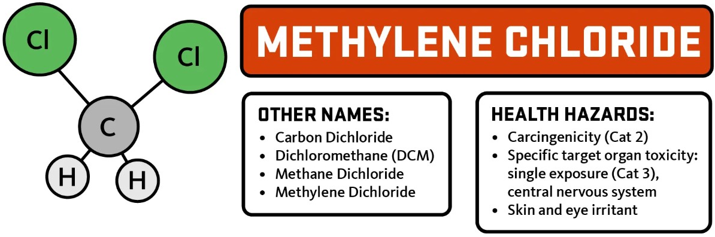
What is Methylene Chloride
Synonyms for methylene chloride include:
  DCM
  MeCl
  MeCl2
  Methane dichloride
  Methylene bichloride
  Methylene dichloride
Non-laboratory products that may contain DCM:
  Paint Strippers and Removers
  Solvent-Based Paints and Coatings
  Adhesives and Adhesive Removers
  Metal Cleaners and Degreasers
  Automotive Products
  Engine Cleaners
  Brake Cleaners
  Lubrication Oil
  Lithography/Printmaking Products
  Heavy-Duty or Specialized Cleaners
DCM is an organochlorine compound that is a colorless, volatile liquid with a chloroform-like, sweet odor and is widely used as a solvent.

Slide 4
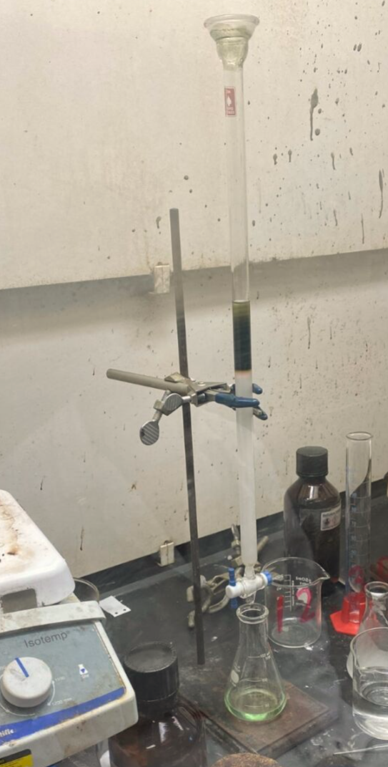
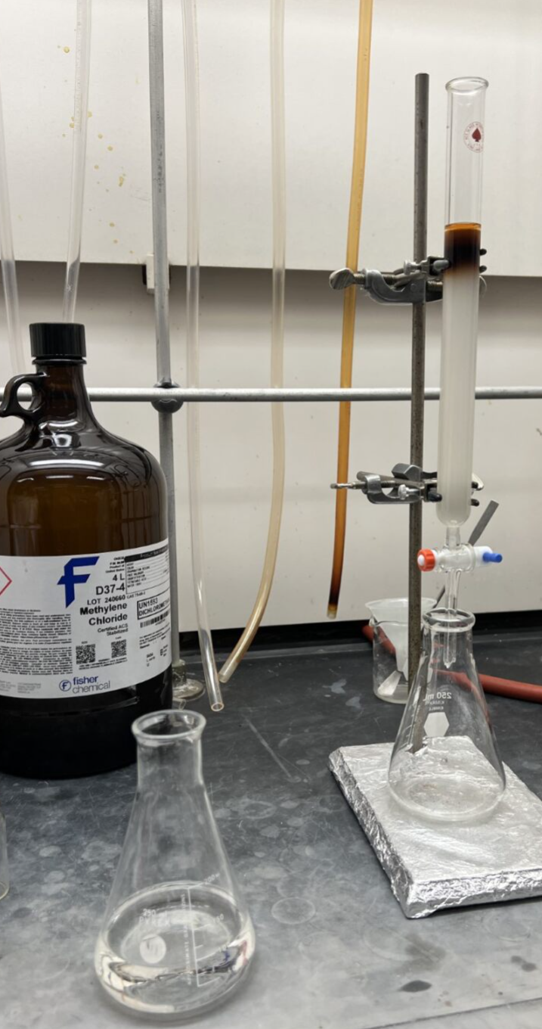
Methylene Chloride in the Laboratory
Often used in laboratories as a solvent because of its polarity, aprotic structure, and low boiling point.
Molecular weight of 84.9 grams/mole.
High vapor pressure of 350.
Odor threshold of 125 ppm.
  If you can smell it, you are well over the exposure limit.
Common lab uses for DCM:
  Liquid Chromatography
  Extractions
  Synthesis
  Purification

Slide 5
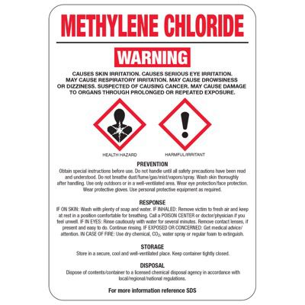
Risks Associated with Methylene Chloride
Common Routes of Exposure:
  Inhalation
  Absorption (skin, eyes, nose, throat)
Symptoms:
  Drowsiness
  Dizziness
  Numbness
  Tingling Limbs
  Nausea
Target Organs:
  Corrosive- can burn the eyes and skin
  Destroy heart and liver tissue
  A known carcinogen
It is important to limit exposure to DCM whenever possible to minimize the risk of injury.

Slide 6

EPA TSCA Standard Requirements
In April 2024, Environmental Protection Agency (EPA) finalized a new rule and workplace protections under the Toxic Substances Control Act (TSCA) for methylene chloride to protect human health.
Most uses of DCM will be banned.
A few uses may continue if a Workplace Chemical Protection (WCPP) is established, including lab use and solvent welding.

Slide 7
Uses That the EPA Rule Doesn’t Apply To
The EPA rule does not apply to the following:
  Materials with less than 0.1% DCM by weight are not subject to the restrictions in this regulation.
  Any pesticide when manufactured, processed, or distributed in commerce for use as a pesticide.

Slide 8

Key Regulatory Dates
5 May 2025
Initial exposure monitoring to determine each potentially exposed person’s exposure for continuing uses must be completed.
Distributing methylene chloride products for consumer use is prohibited.
1 Aug. 2025
(or 3 months after testing)
Provide respiratory protection as outlined.
Require chemically-resistant gloves where dermal contact is possible.
30 Oct. 2025
Develop and implement an Exposure Control Plan.
28 Apr. 2026
Most commercial uses are prohibited after this date.
8 May 2029
DCM may be used for very specific furniture refinishing and aerospace uses until this date, with protections.

Slide 9

EHS Approval
All uses of DCM must be reviewed and approved by EHS.
Exposure monitoring and training is required before DCM use.

Slide 10
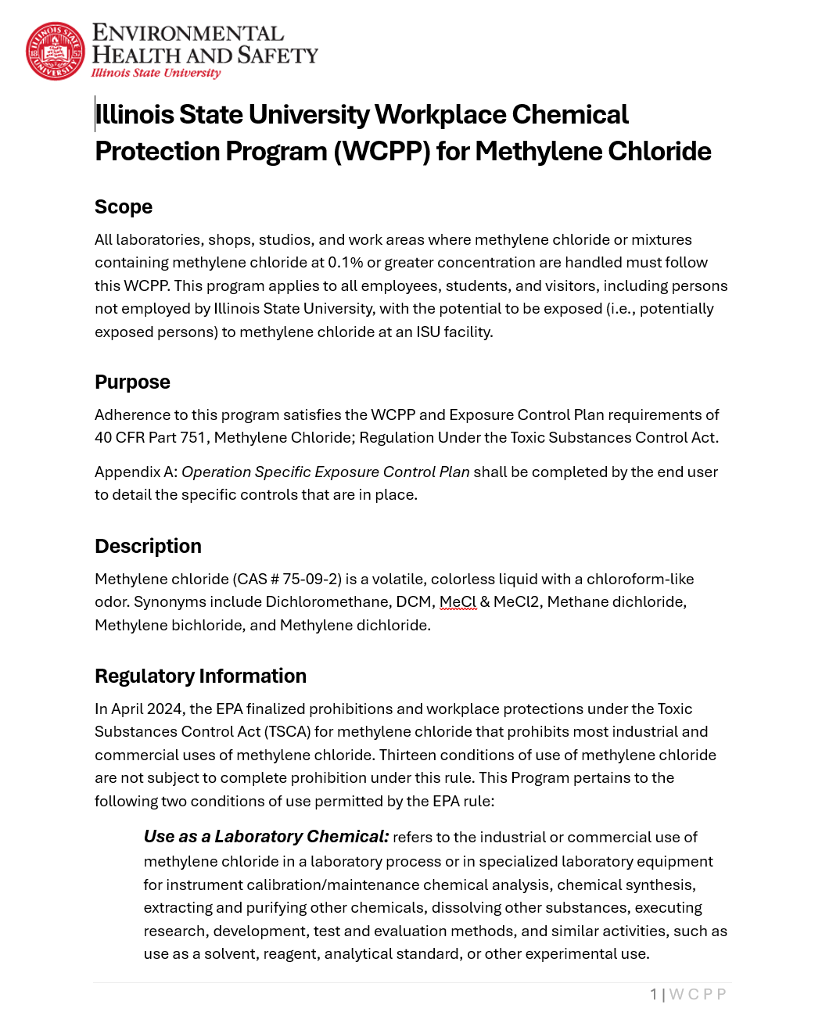
Workplace Chemical Protection Program (WCPP)
WCPP:
  A written program to protect people engaged in conditions of use that are not prohibited, including lab use and solvent welding.
  ISU’s WCPP can be found on the EHS Website.
Exposure Control Plan (ECP)
  A document describing actions taken to mitigate occupational exposures and comply with the WCPP at the lab, department, or institute level.
  Must include information on why DCM use cannot be eliminated and why there are no adequate substitutes.
  Every approved user of DCM must fill out the ECP, make a copy available in the lab, and provide the completed plan to EHS.

Slide 11
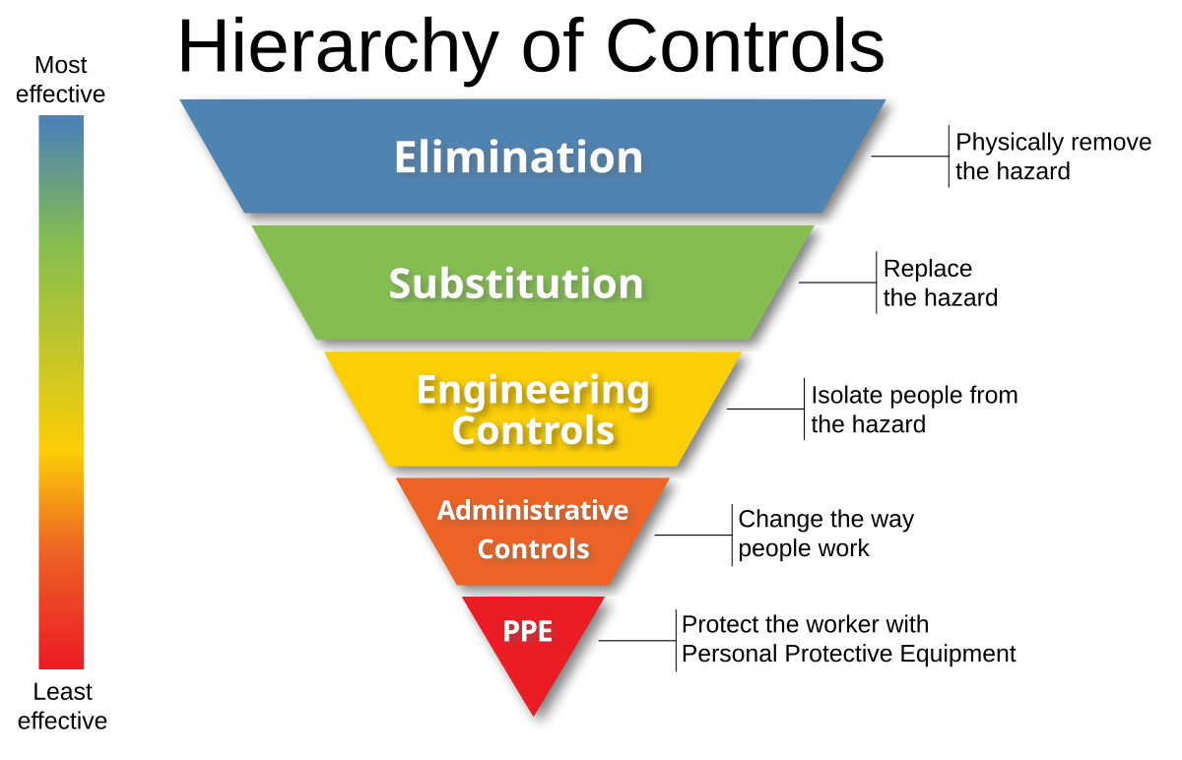
Implementing Exposure Controls
Users must implement each type of control when feasible.
Controls that are not used must be documented in the Exposure Control Plan (ECP).
Learn more about control types on the NIOSH Hierarchy of Controls webpage.

Slide 12
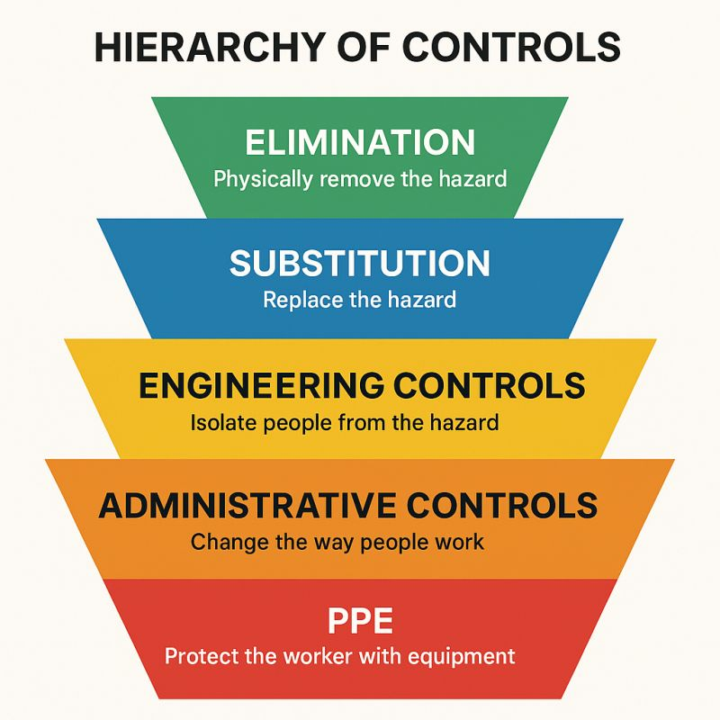
Elimination and Substitution
Elimination is the complete removal of DCM.
Substitution is the replacement of DCM with an alternative.
  Assess the risks posed by potential substitutes.
  Do not use a substitute that is more hazardous than DCM, such as chloroform, trichloroethylene, or n-propyl bromide due to toxicity or hydrochlorofluorocarbons due to ozone depletion.
  Implement controls to address any risks from substitutes that are chosen.

Slide 13

Engineering Controls
When possible, perform work with DCM inside a fume hood.
Ensure hood is functioning properly.
Check for alarms.
Keep items not needed for the work out of the fume hood.
Glove boxes may be used to prevent exposure to DCM if the purge/exhaust line is connected to the building exhaust.
Use other ventilation controls, such as snorkels or exhausted enclosures, if fume hood or glove box use isn’t possible.
All engineering controls require proper training and an assessment of potential exposure by EHS.
Stop all use of DCM if any malfunction of the local exhaust ventilation is suspected.

Slide 14

Administrative Controls
Administrative controls are work practices employed to minimize the risk of exposure during the task by providing the worker with information on hazards and how to work safely.
Review the WCPP and ECP and agree to abide by the information in those documents and this training.
Review the manufacturer’s SDS and additional chemical safety information
Follow standard institute policies for chemical storage and disposal.
Develop written emergency response procedures for unexpected events, such as spills, alarms, unexpected reactions, exposures, etc.

Slide 15
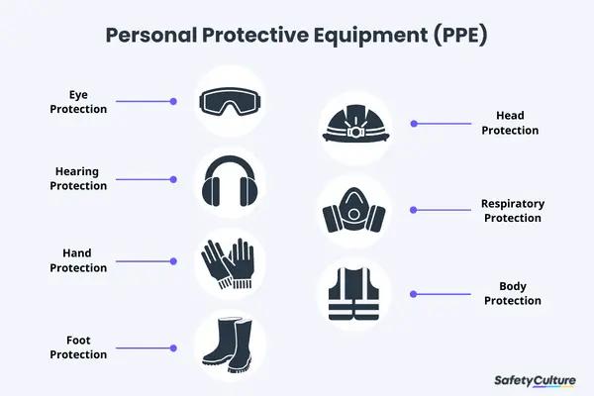
Personal Protective Equipment
Personal protective equipment (PPE) is comprised of clothing and equipment worn to provide a barrier between a hazard and an individual.
PPE is the last line of defense against exposure when other controls are not sufficient or where operations require direct contact with a hazard.
Individuals working with DCM must wear appropriate PPE whenever there is a risk of contact with the chemical.

Slide 16
Personal Protective Equipment
PPE Type | Requirement
Attire | A combination of clothing and shoes that fully cover the legs and feet.
Lab Coat | Required when handling DCM.
Eye Protection | Safety glasses with side shields at a minimum. Safety goggles when there is a greater risk of splashes and for spill cleanup.
Respiratory Protection | Respiratory protection should not be needed if using engineering controls. Where required, additional training and entry into a respiratory protection program is required. Purifying respirators are not allowed for DCM.

Slide 17

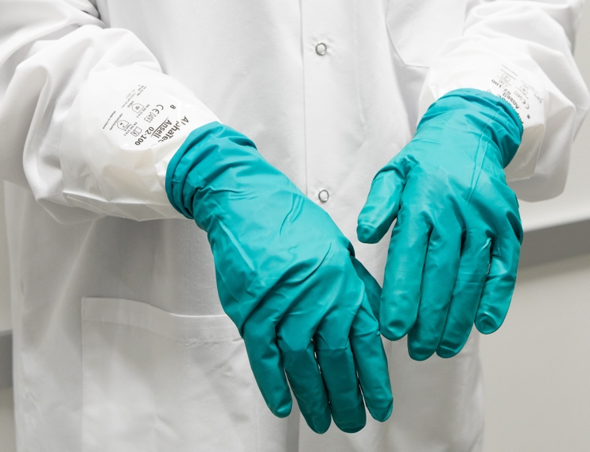
Glove Use
Note: Compatibility with other chemicals in use must also be assessed.
Low-Risk Work
  Examples: Small volumes, low splash risk.
  Double-glove with nitrile or nitrile/neoprene combination gloves (ex. Ansell 93-260)
Higher-Risk Work
  Examples: Spill cleanup, large volumes, or greater splash or contact risk.
  More resistant glove such as Ansell 02-100 liners or SilverShield gloves under a nitrile or nitrile/neoprene glove.
2-100 liners
+
93-260 gloves

Slide 18
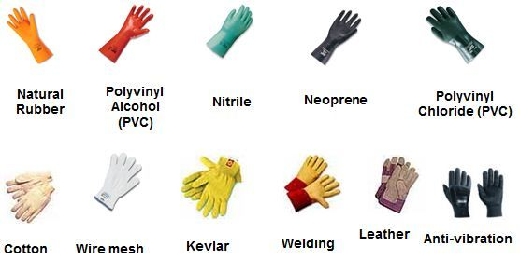
Glove Use Tips
Check that gloves meet the following guidelines.
  Clean and fit well - snug but not too tight, allowing full range of motion.
  Compatible and appropriate to the hazards, including DCM and other chemicals in use at the same time.
  Covers hands and wrists in combination with lab coat.
  Chosen to provide desired level of dexterity for procedures.

Slide 19

Glove Use
Store
Store gloves away from moisture or direct sunlight.
Minimize
Minimize contact and splashing as much as possible.
Monitor
Monitor the condition of the gloves before and during use. Do not use if there are damaged or show signs of wear, such as holes, tears, or discoloration.
Change
Change disposable gloves frequently.

Slide 20
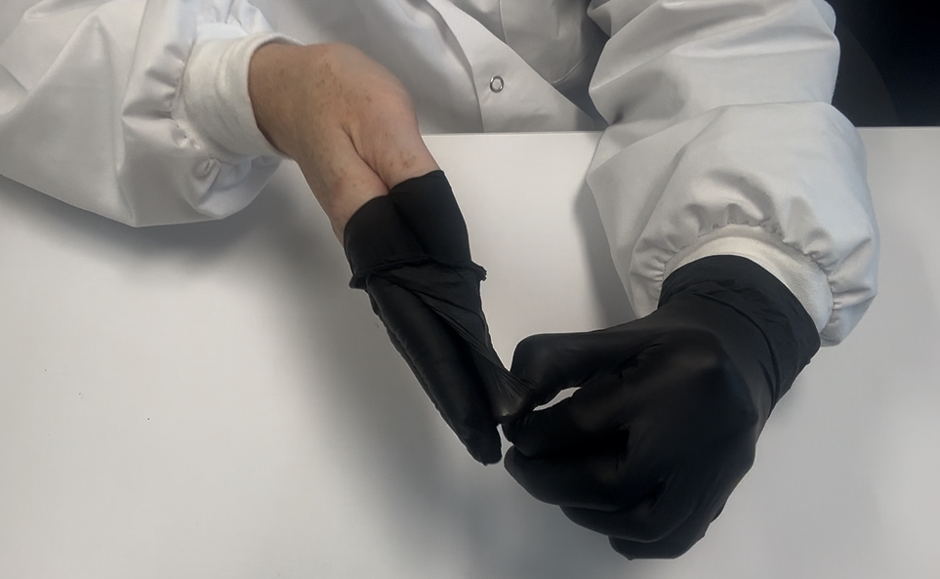
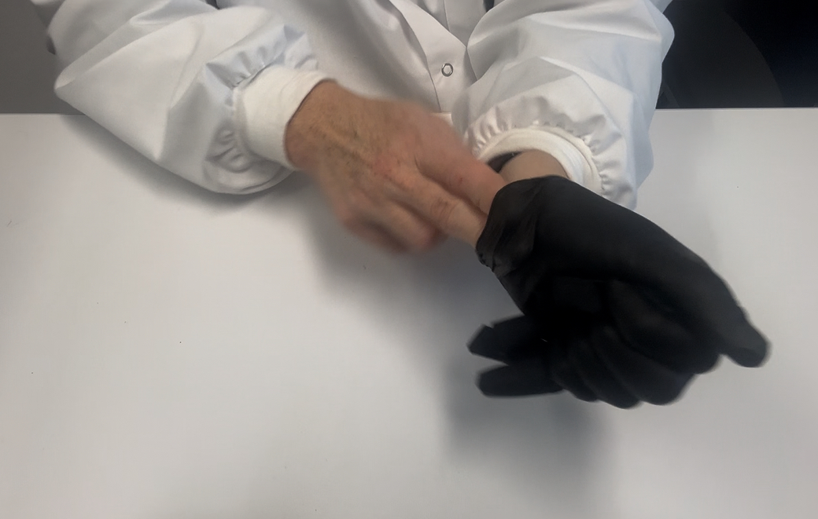
Glove Removal
Ensure the glove exteriors do not touch your skin during removal.
Pinch the wrist of one glove without touching your skin and peel it off, turning it inside out.
Slide an ungloved finger under the wrist of the remaining glove and peel it off, enclosing the first glove inside.
Place the gloves in a designated hazardous waste container.

Slide 21
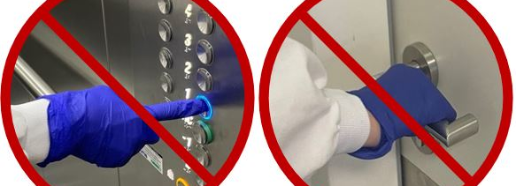
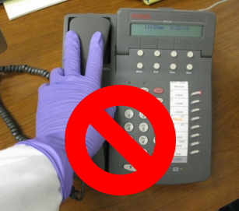
Avoid Cross-Contamination
Avoid touching personal items like cell phones while wearing gloves.
Do not touch your face or clothing with gloves.
Do not bring chemicals or contaminated materials into demarcated clean areas within the lab.
Do not wear gloves outside the lab.
Wash your hands after removing gloves and before leaving the lab.

Slide 22
Emergency Procedures
Skin Contact
Treatment starts immediately following exposure. Do not wait to remove chemicals once they are on the skin.
Remove all potentially contaminated clothing and jewelry and treat as hazardous waste.
Flush affected skin area using sink using sink if on hands or arms or safety shower for 15 minutes.
Take a copy of the SDS and seek medical attention.
Report the incident to your supervisor and EHS.
Eye Contact
Rinse eyes at an eyewash station for at least 15 minutes. Be sure to hold the lids open.
Seek medical attention.
Report the incident to your supervisor and EHS.

Slide 23
Emergency Procedures
Inhalation
Move to a location with fresh air.
Seek medical attention.
Ingestion
Do not induce vomiting if DCM is swallowed.
Never give anything by mouth to an unconscious person.
Call 911 for medical assistance.

Slide 24
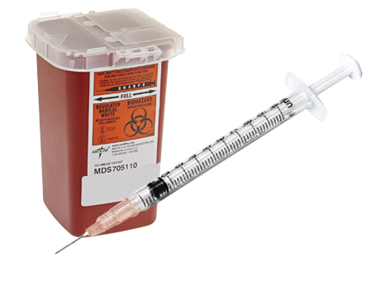
Emergency Procedures
Sharps Injury
  Injection of DCM, such as through a needlestick injury, can cause significant tissue damage. See “Safety First: A Recent Case of a Dichloromethane Injection Injury” (ACS Cent. Sci. 2020, 6, 2, 83–86). Note that there are graphic images in the paper.
  Seek immediate medical assistance. Notify your supervisor and EHS.
  Significant tissue damage may occur without prompt treatment at a hospital. Clearly state that dichloromethane (methylene chloride) was involved in the injury, provide the SDS, and describe any symptoms such as discoloration or feeling of heat in the affected area.

Slide 25
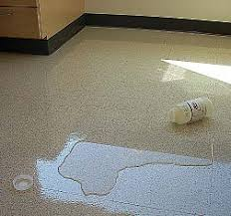
Emergency Procedures
Spills outside fume hood or ventilated enclosure:
  Alert others of the spill.
  If able to do so, open up all fume hoods in the lab and press “Emergency Max” mode.
  Evacuate to a safe distance and prevent entry.
  Contact EHS.
  Remain in a safe location until EHS or other response personnel arrive.

Slide 26
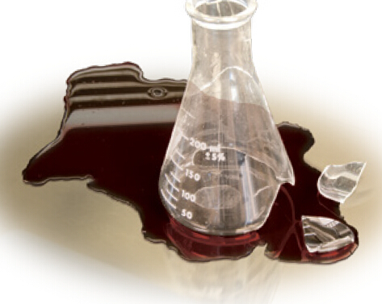
Emergency Procedures
Spill inside fume hood or ventilated enclosure:
  A person may assist in the clean-up effort of small amounts of DCM in a properly functioning fume hood if trained and comfortable.
  Wear PPE described above and use appropriate spill supplies such as absorbent pads and tongs.
  Collect debris in appropriate container made of a compatible material such as high-density polyethylene (HDPE) that can be sealed.
  Label container with appropriately completed hazardous waste tag and request a waste pickup from EHS.
  If not trained or if uncomfortable with cleanup, close the fume hood sash and contact EHS.

Slide 27

Thank you to CSHEMA for the materials used in this training.

Slide 28
Resources
Risk Management for Methylene Chloride - EPA webpage for DCM
FACT SHEET: Regulation of Methylene Chloride under TSCA - 2-page summary of key points in the EPA rule.
COMPLIANCE GUIDE: Regulation of Methylene Chloride under TSCA - Guide the EPA published to assist with compliance.
Final Risk Management Rule for Methylene Chloride - This is the complete, official rule published in the Federal Register.

